Slide 1
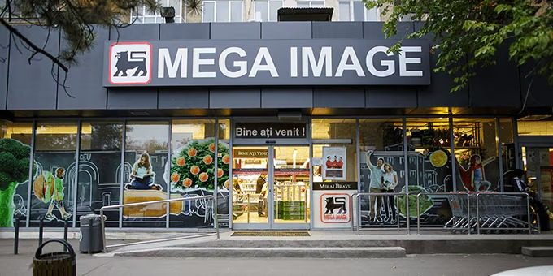
AD Grocery
Avram Sorin-Alexandru
Grasu Costin-Alexandru Lepinzar Stefan

Slide 2
Objectives
Building a Budget Planning app
User-friendly
Customizable
Made for everyone
Waste-free

Slide 3
Implementation
First and foremost, we show how much benefits does shopping at Mega Image bring
3 Approaches:
Giving power to the user
Getting the cheapest deals
Smart Grocery List (Cost, Preferences, Expiration)

Slide 4

Technologies
A mobile android app
Made in Android Studio with Kotlin
Our first mobile app

Slide 5
Problems encountered
Learning from the ground up a new engine
Designing the Smart Grocery List Algorithm
Somehow implementing the photos

Slide 6
Our solution
Started rough, but we powered through (took a lot of caffeine)
Drew out a Product Utility scheme, after rethinking our approach
Took a lot of methods (a lot.)

Slide 7
Future
Gamification
Level system
Bring back the childhood wander of the Mega cards
Possible dueling card game
Upgrading the Smart Grocery List Algorithm

Slide 8

DEMO Time!

Slide 9
Q&a

